Slide 1


Slide 2
Natural Language Processing
Lecture –
Artificial Neural Networks
Author:
Dr. Rao Muhammad Adeel Nawab
Instructor:
Mr. Waqar Ashiq

Slide 3
Lecture Outline
1
Recap
2
Artificial Neural Networks
3
General Architecture - Artificial Neural Networks
4
Perceptron - Two Layer Artificial Neural Networks
5
Machine Learning Cycle – Perceptron
6
Multi-layer Artificial Neural Networks
7
Overfitting – Artificial Neural Networks

Slide 4
What are Neural Networks ?
An inspiration from biological neural systems, the most robust learning systems we know.
Attempt to understand natural biological systems through computational modeling.
Neural networks in artificial intelligence draw significant inspiration from biological neural systems, particularly the human brain. The basic building blocks of both systems are neurons: biological neurons in the human brain and artificial neurons in computational models.

Slide 5
Neural Network Learning
Learning approach of NN algorithm based on modeling while learning in biological neural systems is based on adaptation.
Two main algorithms:
Perceptron: Initial algorithm for learning simple neural networks (with no hidden layer) developed in the 1950’s.
Backpropagation: More complex algorithm for learning multi-layer neural networks developed in the 1980’s.

Slide 6
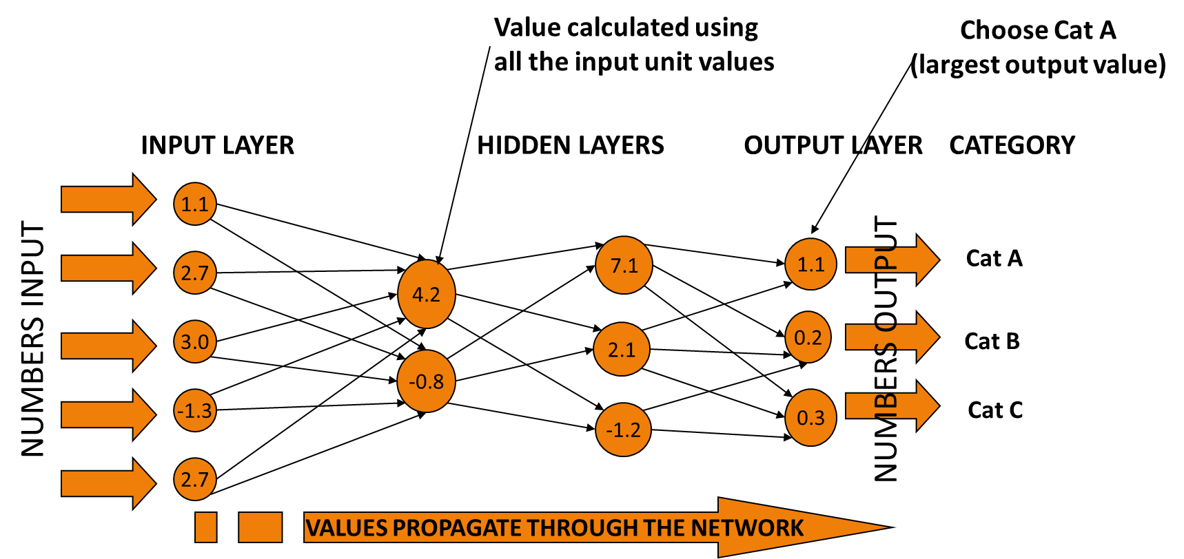
General Architecture - Artificial Neural Networks
Three Main Layers
Input Layer
Hidden Layer
Output Layer

Slide 7
General Architecture - Artificial Neural Networks (Cont.)
Each Layer contains one or more Units
Input Units
Units in the Input Layer called Input Units
Hidden Units
Units in the Hidden Layer called Hidden Units
Output Units
Units in the Output Layer called Output Units

Slide 8
Number of Units at each Layer (Cont.)
Question 03
How many Units should be there at Hidden Layer?
Answer
There is no definite answer to this question
Normally, people randomly select
Number of Hidden Layers and
Number of Hidden Units

Slide 9
SoftMax Layer - ANN
Considering Vehicle Categorization Problem
Output Units contain the Output generated by ANN
Problem
How can we interpret the vectors at Output Units to categorize Image as Car / Bus / Tank?
A Possible Solution
Use a Softmax Function

Slide 10
SoftMax Layer – ANN (Cont.)
Softmax Function
Softmax Function takes vectors as input and converts them into probabilities such that sum of probabilities of all Output Units is 1
The Output Unit with the highest probability will be the predicted Class / Category of an instance / example
Softmax Layer is the last Layer of ANN

Slide 11
Mathematical Functions – ANNs
ANNs embed giant Mathematical Functions (e.g. relu, sigmoid etc.)
All the Hidden Units and Output Units in an ANN, have the
Same Mathematical Function
Input to a Mathematical Function
Weighted Sum of Inputs (S)

Slide 12
Fully Connected ANN vs Partially Connected ANN
Fully Connected ANN
A Fully Connected Neural Network consists of a series of Fully Connected Layers
Fully Connected Layer
In a Fully Connected Layer, each Unit receives input from every Unit of the previous layer
Partially Connected ANN
A Partially Connected Neural Network consists of a series of Partially Connected Layers
Partially Connected Layer
In a Partially Connected Layer, each Unit does not receive input from every Unit of the previous layer

Slide 13
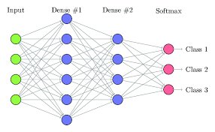
Example – Fully Connected ANN

Slide 14
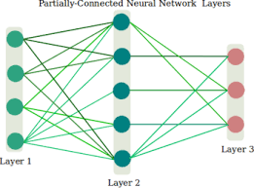
Example – Partially Connected ANN

Slide 15
Feed Forward Network
Question
Why ANN is called a Feed Forward Network?
Answer
A Simple ANN is also called Feed Forward Network because numbers in the ANN, move in a forward direction
i.e. Input Layer == > Hidden Layer(s) == > Output Layer
Note that calculations are performed at each Hidden and Output Unit

Slide 16
Weights – ANN
The edges between Input-Hidden Units, Hidden-Hidden Unit and Hidden-Output Unit contain the
Weights
Recall
Hypothesis (h) Representation in ANNs
Combination of Weights between Units
To Train ANN
Initially, Weights are randomly assigned
Normally, small Weights are assigned in a range of [-0.5 to +0.5]

Slide 17


ANNs have Black Box Representation
Model / h returned by Learner
Best Combination of Weights between Units
ANNs are said to have Black Box Representation because
Useful knowledge about learned concept (or Model / h) is difficult to extract

Slide 18
Importance – ANN Architecture
The Architecture of ANN plays an important role on the
Performance and computational cost of ANN
Important Parameters to consider in designing ANN Architecture
Main Parameters
No. of Input Units
No. of Hidden Layers
No. of Hidden Units at each Hidden Layer
No. of Output Units
Mathematical Function at each Hidden and Output Unit
Weights between Units
ANN will be Fully Connected or Not?

Slide 19
Types of Artificial Neural Networks
ANN can be categorized based on number of hidden layers contained in ANN architecture
01
Two Layer Neural Network (Perceptron)
Contains 0 hidden layers
Multi Layer Neural Network
Regular Neural Network
Contains 1 hidden layer
Deep Neural Network
Contains >1 hidden layers
02

Slide 20
Two layer Artificial Neural Network (Perceptron)
Multiple input nodes
Single output node
Takes weighted sum of the inputs
Unit function calculates the output for the network
x₁
w₁
x₂
w₂
∑ ?
ŷ
w₃
x₃
w_{n}
x_{n}

Slide 21
Perceptron Example – Sample Data
Consider the Sample Data
Instance No. | Input | Output
E₁ | Bad | Negative
E₂ | Good Product | Positive
E₃ | Best product | Positive

Slide 22
Sample Data (Cont.)
Consider the Sample Data Features
Instance No. | Input |  |  |  | Output
 | Bad | Product | Good | Nice
E₁ | 1 | 0 | 0 | 0 | -1
E₂ |  | 1 | 1 | 0 | +1
E₃ | 0 | 1 | 0 | 1 | +1

Slide 23
Perceptron Example
Feature 1
x₁
0.25
+1 Pos
If S> 0
Feature 2
x₂
0.25
S
ŷ
0.25
Feature 3
x₃
0.25
Otherwise
-1 Neg
x₄
Feature 4
S= 0.25*x₁ + 0.25*x₂ + 0.25*x₃ + 0.25*x₄

Slide 24
Perceptron Example
Calculation (Step-1): (Instance No. 1)
X₁ = 1
X₂ = 0
X₃ = 0
X₄ = 0
S= 0.25*(1) + 0.25* (0) + 0.25*(0) + 0.25* (0) = 0.25
0.25 > 0, so the output of ANN is +1
So the image is categorized as “Pos”
Target : “Neg”
1
x₁
0.25
+1 Pos
If S> 0
0
x₂
0.25
S
ŷ
0.25
0
x₃
0.25
Otherwise
-1 Neg
x₄
0

Slide 25
Learning Algorithm
Weights are randomly initialized.
For each training example E
Calculate the observed output from Perceptron, o(E)
If the target output t(E) is different to o(E)
Then update all the weights so that o(E) becomes closer to t(E)
This process is done for every example
It is not necessary to stop when all examples are used.
Repeat the cycle again (an epoch) until network produces the correct output

Slide 26
Perceptron Training Rule (How to update weights)
When t(E) is different from o(E)
Add ∆_{i} to weight w_{i}
Where change ∆_{i} = ɳ(t(E) – o(E) ) x_{i} → ɳ is learning rate (Usually very small value)
Do this for every weight in the network
Let ɳ=0.1
Calculating the error values
Calculating the New Weights
∆₁ = ɳ (t(E) – o(E) )* x₁
= 0.1 ( -1 – (+1)) * 1 = -0.2
wʹ₁ = w₁ +∆₁ = 0.25 + (-0.2) = 0.05
∆₂ = ɳ (t(E) – o(E) )* x₂
= 0.1 ( -1-1) * 0 = 0
wʹ₂ = w₂ +∆₂ = 0.25 + 0 = 0.25
∆₃ = ɳ (t(E) – o(E) )* x₃
= 0.1 ( -1-1) * 0 = 0
wʹ₃ = w₃ +∆₃ = 0.25 + 0 = 0.25
∆₄ = ɳ (t(E) – o(E) )* x₄
= 0.1 ( -1-1) * 0 = 0
wʹ₄ = w₄ +∆₄ = 0.25 + 0 = 0.25

Slide 27
Perceptron Example
Calculation (Step-2):
X₁ = 1
X₂ = 0
X₃ = 0
X₄ = 0
S= 0.05*(1) + 0.25* (0) + 0.25*(0) + 0.25* (0) = 0.05
0.05 > 0, so the output of ANN is +1
So the image is categorized as “Pos”
Target : “Neg”
1
x₁
0.05
+1 Pos
If S> 0
0
x₂
0.25
S
ŷ
0.25
0
x₃
0.25
Otherwise
-1 Neg
0
x₄

Slide 28
Perceptron Training Rule (How to update weights)
When t(E) is different from o(E)
Add ∆_{i} to weight w_{i}
Where ∆_{i} = ɳ(t(E) – o(E) ) x_{i} → ɳ is learning rate (Usually very small value)
Do this for every weight in the network
Let ɳ=0.1
Calculating the error values
Calculating the New Weights
∆₁ = ɳ (t(E) – o(E) )* x₁
= 0.1 ( -1 -1 ) * 1 = -0.2
wʹ₁ = w₁ +∆₁ = 0.05 - 0.2 = - 0.15
∆₂ = ɳ (t(E) – o(E) )* x₂
= 0.1 ( -1-1) * 0 = 0
wʹ₂ = w₂ +∆₂ = 0.25 + 0 = 0.25
∆₃ = ɳ (t(E) – o(E) )* x₃
= 0.1 ( -1-1) * 0 = 0
wʹ₃ = w₃ +∆₃ = 0.25 + 0 = 0.25
∆₄ = ɳ (t(E) – o(E) )* x₄
= 0.1 ( -1-1) * 0 = 0
wʹ₄ = w₄ +∆₄ = 0.25 + 0 = 0.25

Slide 29
Perceptron Example
Calculation (Step-3):
X₁ = 1
X₂ = 0
X₃ = 0
X₄ = 0
S= - 0.15*(1) + 0.25* (0) + 0.25*(0) + 0.25* (0) = - 0.15
- 0.15 < 0, so the output of ANN is -1
So the image is categorized as “Neg”
Target : “Neg”
1
x₁
-0.15
+1 Pos
If S> 0
0
x₂
0.25
S
ŷ
0.25
0
x₃
0.25
Otherwise
-1 Neg
x₄
0

Slide 30
Another Example (AND)
X₁ | X₂ | X₁ AND X₂
0 | 0 | 0
0 | 1 | 0
1 | 0 | 0
1 | 1 | 1
If S > 0
+1 ON
0
x₁
W₁=0.5
S
ŷ
W₂=0.5
1
x₂
-1 OFF
X1 = 0
X2 = 1,
ɳ = 0.1
t(E) = -1
Weights | Step-1 | Step-2 | Step-3 | Step-4
w1 | 0.5 | 0.5 | 0.5 | 0.5
w2 | 0.5 | 0.3 | 0.1 | -0.1
Weighted Sum | 0.5 | 0.3 | 0.1 | -0.1
Observed Output | +1 | +1 | +1 | -1

Slide 31
Another Example (AND)
X₁ | X₂ | X₁ AND X₂
0 | 0 | 0
0 | 1 | 0
1 | 0 | 0
1 | 1 | 1
If S > 0
+1 ON
0
x₁
0.5
S
ŷ
-0.1
1
x₂
-1 OFF
X1 = 1
X2 = 0,
ɳ = 0.1
t(E) = -1
Weights | Step-1 | Step-2 | Step-3 | Step-4
w1 | 0.5 | 0.3 | 0.1 | -0.1
w2 | -0.1 | -0.1 | -0.1 | -0.1
Weighted Sum | 0.5 | 0.3 | 0.1 | -0.1
Observed Output | +1 | +1 | +1 | -1

Slide 32
Another Example (AND)
X₁ | X₂ | X₁ AND X₂
0 | 0 | 0
0 | 1 | 0
1 | 0 | 0
1 | 1 | 1
If S > 0
+1 ON
0
x₁
-0.1
S
ŷ
-0.1
1
x₂
-1 OFF
X1 = 1
X2 = 1,
ɳ = 0.1
t(E) = +1
Weights | Step-1 | Step-2
w1 | -0.1 | 0.1
w2 | -0.1 | 0.1
Weighted Sum | -0.2 | 0.2
Observed Output | - 1 | +1

Slide 33
Why Bias is Required….?
Improves model performance and learning
Bias helps the model better fit the training data.
It often helps the model converge faster during training.
Technically, it lets the model learn more complex patterns.

Slide 34
New Representation for Perceptron
Threshold function has become this
Special input, which is always 1
1
w₀
If S > 0
x₁
w₁
+1
S
ŷ
w₂
x₂
-1
Otherwise
w_{n}
x_{n}
S= w₀ + w₁*x₁ + w₂*x₂ . . . . . . . w_{n}*x_{n}

Slide 35
Use of Bias
Bias
x₀
Bias is just like an intercept added in a linear equation.
If S > 0
+1 ON
0
x₁
0.5
S
ŷ
0.5
output = sum (weights * inputs) + bias
1
x₂
-1 OFF
The output is calculated by multiplying the inputs with their weights and then passing it through an activation function like the Sigmoid function, etc. Here, bias acts like a constant which helps the model to fit the given data.

Slide 36
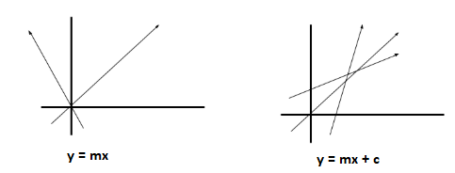
Use of Bias
A simpler way to understand bias is through a constant c of a linear function
y =mx + c
It allows us to move the line down and up fitting the prediction with the data better. If the constant c is absent then the line will pass through the origin (0, 0) and we will get a poorer fit.

Slide 37
Example (AND) with Bias
Bias
x₀=1
X₁ | X₂ | X₁ AND X₂
0 | 0 | 0
0 | 1 | 0
1 | 0 | 0
1 | 1 | 1
W₀=0.5
If S > 0
+1 ON
0
x₁
W₁=0.5
S
ŷ
W₂=0.5
1
x₂
-1 OFF
X1 = 0
X2 = 1,
ɳ = 0.1
t(E) = -1
Weights | Step-1 | Step-2 | Step-3 | Step-4
w0 | 0.5 | 0.3 | 0.1 | -0.1
w1 | 0.5 | 0.5 | 0.5 | 0.5
w2 | 0.5 | 0.3 | 0.1 | -0.1
Weighted Sum | 1 | 0.6 | 0.2 | -0.2
Observed Output | +1 | +1 | +1 | -1

Slide 38
Example (AND) with Bias
Bias
x₀=1
X₁ | X₂ | X₁ AND X₂
0 | 0 | 0
0 | 1 | 0
1 | 0 | 0
1 | 1 | 1
W₀=-0.1
If S > 0
+1 ON
0
x₁
W₁=0.5
S
ŷ
W₂=-0.1
1
x₂
-1 OFF
X1 = 1
X2 = 0,
ɳ = 0.1
t(E) = -1
Weights | Step-1 | Step-2
w0 | -0.1 | -0.3
w1 | 0.5 | 0.3
w2 | -0.1 | -0.1
Weighted Sum | 0.4 | 0
Observed Output | +1 | -1

Slide 39
Example (AND) with Bias
Bias
x₀=1
X₁ | X₂ | X₁ AND X₂
0 | 0 | 0
0 | 1 | 0
1 | 0 | 0
1 | 1 | 1
W₀=-0.3
If S > 0
+1 ON
0
x₁
W₁=0.3
S
ŷ
W₂=-0.1
1
x₂
-1 OFF
X1 = 1
X2 = 1,
ɳ = 0.1
t(E) = +1
Weights | Step-1 | Step-2
w0 | -0.3 | -0.1
w1 | 0.3 | 0.5
w2 | -0.1 | 0.1
Weighted Sum | 0 | 0.5
Observed Output | -1 | +1

Slide 40
Example (AND) with Bias
Bias
x₀=1
After 2 Epochs
W₀= - 0.3
If S > 0
+1 ON
X₁ | X₂ | X₁ AND X₂
0 | 0 | 0
0 | 1 | 0
1 | 0 | 0
1 | 1 | 1
0
x₁
W₁= 0.3
S
ŷ
W₂= 0.1
1
x₂
-1 OFF
Final Weights
X1 = 0
X2 = 1,
ɳ = 0.1
t(E) = -1
Weights
w0 | - 0.3
w1 | 0.3
w2 | 0.1

Slide 41
Learning in Perceptron
Need To Learn
Both the weights between input and output units
And the value for the threshold
Make Calculations easier by:
Thinking of the threshold as a weight from a special input unit where the output from the unit is always 1
Exactly the same result:
But we only have to worry about learning weights

Slide 42
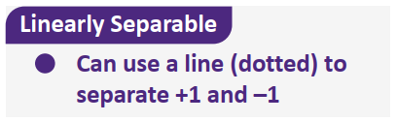
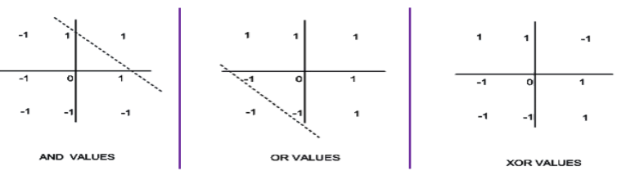
Limitations of Perceptron
Cannot learn some simple Boolean functions
Can only learn linearly separable Boolean functions

Slide 43
THANKS

